Slide 1
Course Title: Programming Language I
Course Code: CSE110
Semester: Fall 2022

Slide 2
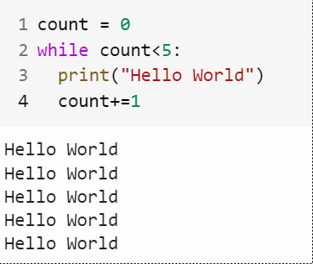
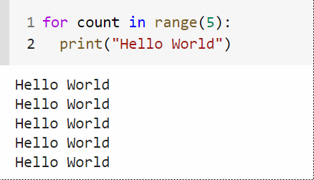
Introduction to Iterations

Slide 3
for Loop
The for loop in Python is used to iterate over a sequence (list, tuple, string) or other iterable objects.
Syntax:
for val in sequence:
loop body

Slide 4
Introduction to Iterations
Suppose we have a list and we want to print the elements of the list.
my_list = [1,2,3,4,5]
How can we use loop to print the elements of the list??

Slide 5
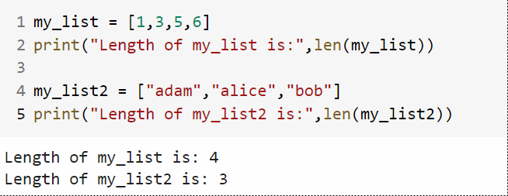
len() function
The len() function returns the number of items in an object

Slide 6
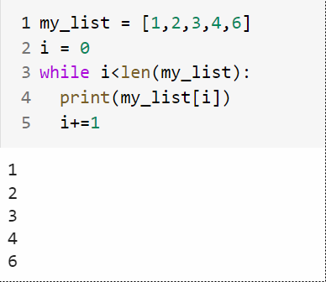
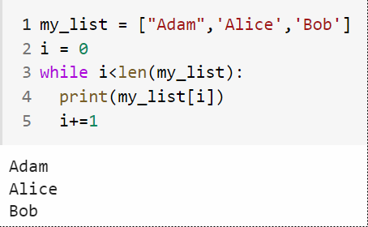
Using while Loop

Slide 7
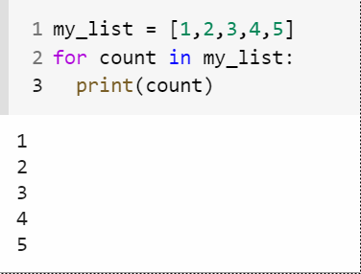
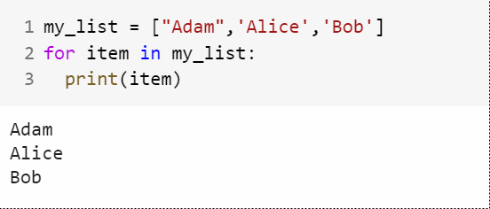
Using for Loop

Slide 8
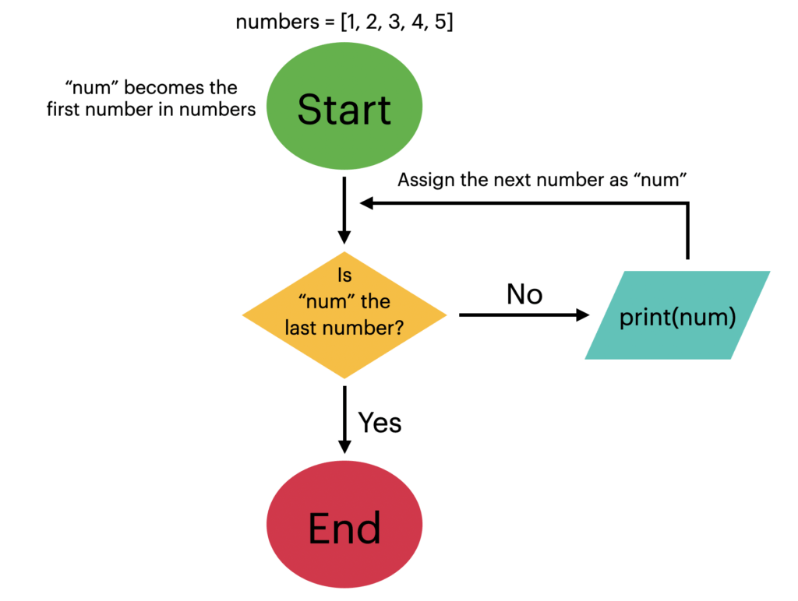
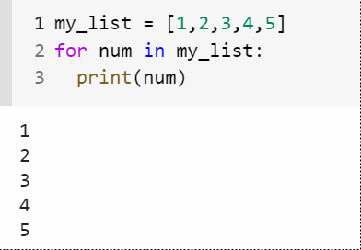
for loop Flowchart

Slide 9
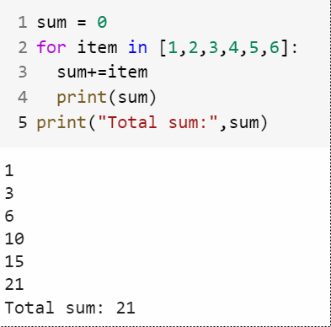
Example of for loops

Slide 10
Example of for loops
Write a program which will find the maximum number from a given list
num = [2,4,6,10,20,50,1,5,3]

Slide 11
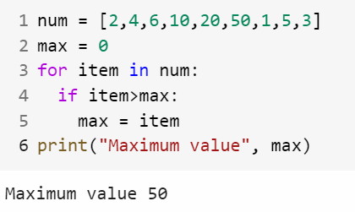
Example of for loops
Write a program which will find the maximum number from a given list

Slide 12
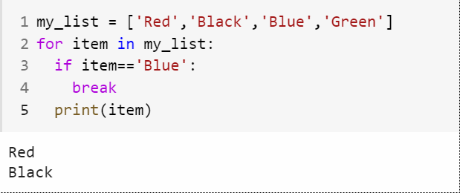
break Statement

Slide 13
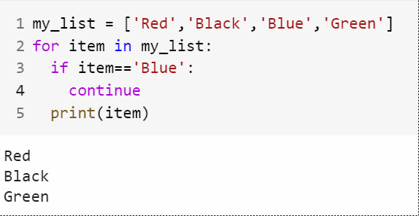
continue Statement

Slide 14
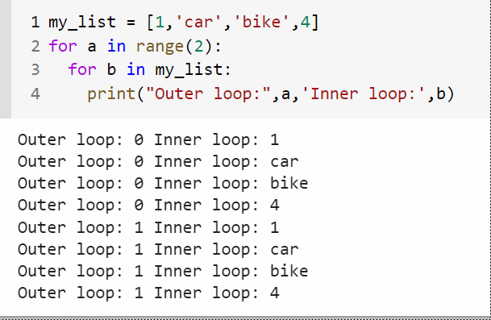
Nested for statement

Slide 15
pass statement
Pass statement is a null statement
When the pass statement is executed, nothing happens, but you avoid getting an error when empty code is not allowed.
Empty code is not allowed in loops, function definitions, class definitions, or in if statements.

Slide 16
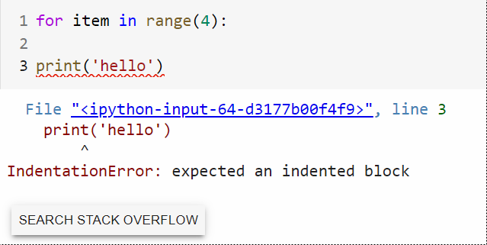
pass statement

Slide 17
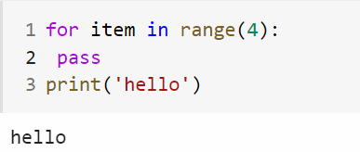
pass statement

Slide 18
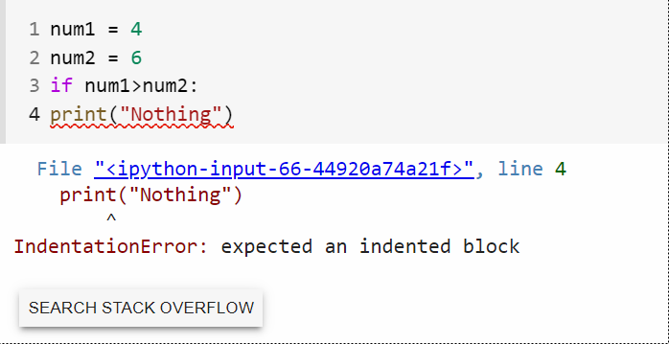
pass statement

Slide 19
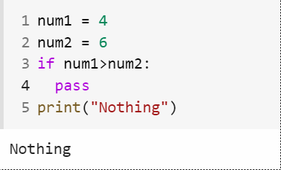
pass statement

